Slide 1
GAAD Hackathon
Playback Brief
Design for All
Suremy Rahugnanam
Mike Stevens

Slide 2
Why
There are potential customers with accessibility needs, who fall under the target audience, but cannot use the product/service due to limitations on its accessibility.
By increasing the accessibility of our product
create a better customer experience (grow Net Promotor Score by 15-25 points).
grow our revenue (5-10%)

Slide 3
What
There are 3 specific accessibility categories that our product does not adequately accommodate that we will target
Visual (red submit buttons may appear as green)
Audio (no closed caption)
Physical (finger dexterity)

Slide 4
Who
There are 3 specific accessibility groups we will target
Color blind (protonomaly)
Hearing impaired severity
Motor skills/dexterity challenged

Slide 5
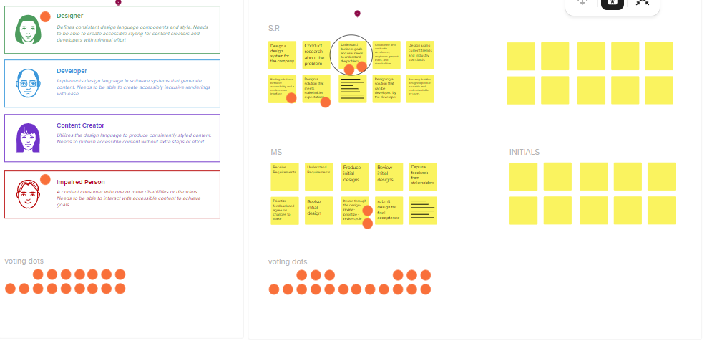
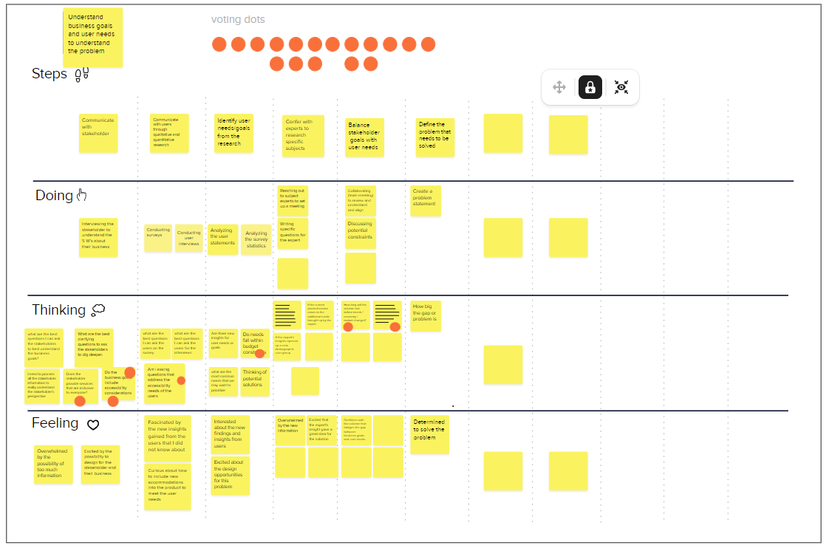
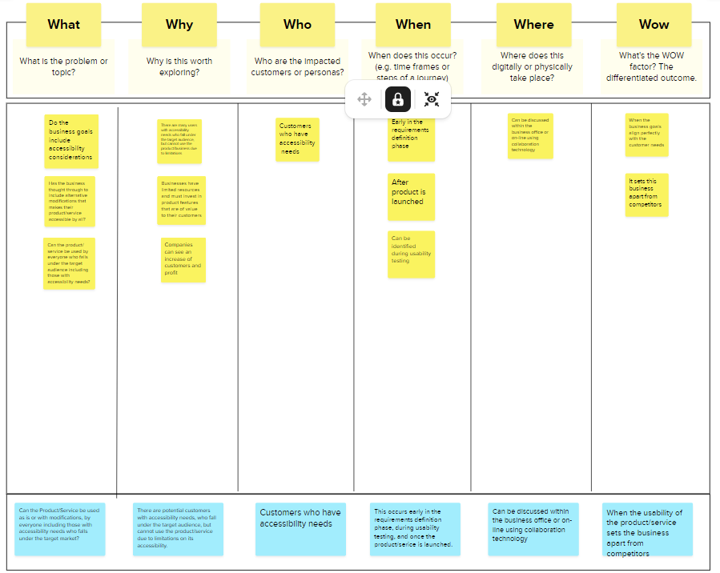
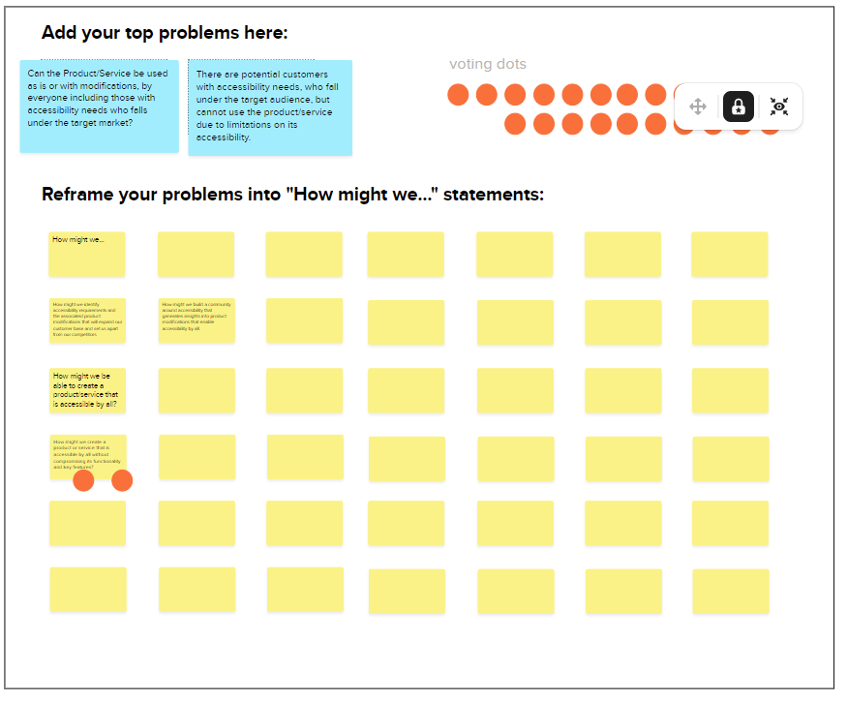
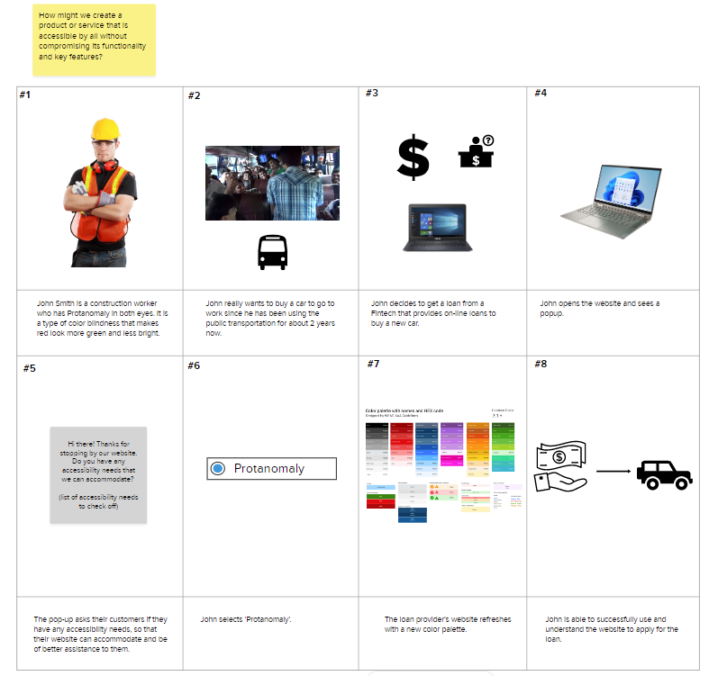

Slide 6
Where
This is happening on digital platforms that offer services to users that assist them in their daily lives
Web-sites
Computer Applications

Slide 7
When
This problem occurs after products and services are released for consumers use.
To prevent this from happening, companies can
Include accessibility considerations in their product requirements
Research, focus groups, consult experts
Include people with accessibility needs in their product testing process
Iterate based upon feedback
Build and use customer feedback on existing products and services to maintain consistency

Slide 8
Wow
By increasing the accessibility of their digital products, financial institutions will set themselves apart from their competitors
Attract more customers whose values align with the institution
Improve customer experience

Slide 9
Design for All Play Back Brief Suremy Rahugnanam Mike Stevens

